Slide 1
How Big Mountain Resort Can Maximize Returns ?
Context
Problem
Big mountain is a top class skiing resort in Montana. It has some of the finest facilities for skiers and riders of all levels and abilities. Around 350000 people visit and enjoy skiing and snowboarding each year at the resort. The resort charges premium in above average market prices.
How exactly Big Mountain can increase revenue without undermining profit through
Increasing ticket prices and/or
Increasing facility utilization
Data
Scope
We have up to date information about resorts which operate in same market segment. This information contains details about location, facilities, number of days open, ticket price etc.
Focus of this initiative is to analyse and predict fair ticket price which Big Mountain can charge in the next season.
We will not analyse cost details as they are unavailable.
Stakeholders
Success Criteria
Jimmy Blackburn - Director of Operations
Alesha Eisen - Database Manager
Executive members
Make a recommendation for a new pricing strategy to the executive members.

Slide 2
Recommendations
Big mountain resort charges $81 for a skiing ticket and it is the most expensive resort in Montana.
Our model is suggesting that there is scope to increase ticket prices. We propose some solutions below where we can justify the price hike to customers by adding additional facilities.
Solution 2 stands out in terms of profitability, feasibility and acceptability.
Impact
Solution
01
Revenue : + 7.0 million
Profit : + 7.0 million
Increase the ticket price by $4.
The projected fair price is $95.8 with +/- $10.4 variation. We can safely increase price to lower bound of $85.
02
Revenue : + 5.9 million
Profit : + 4.2 million
Increase vertical drop by 200 feet, install new chair and close 5 least used runs
Increase ticket by $3.4
Assume effective cost change is $1 per ticket
03
Revenue : + 3.5 million
Profit : + 1.9 million
Increase vertical drop by 150 feet, install a chair and add a run
Increase ticket by $2
Assume effective increase in per ticket cost is $0.9
04
Revenue : + 3.5 million
Profit : + 1.8 million
Scenario 03 + increase snowmaking area by 2 acres
Increase ticket by $2
Assume effective increase in per ticket cost is $1
We are assuming 350,000 visitors in the next season and an average of 5 tickets/visitors. Vertical drop can be increase to 200 feet.

Slide 3
Data Processing
We have two potential candidates for target namely AdultWeekday & AdultWeekend ticket price. AdultWeekend has less missing values, more variation and is always greater than AdultWeekday price. Hence, we choose AdultWeekend as our target.
Raw data contains 330 rows and 27 columns.. Each row represents an unique resort and each column represents a characteristic of that resort. Data is already in tidy format.
We have dropped the records(~16%) where target AdultWeekend is missing. We dropped AdultWeekday and fastEight columns because of high missing %.
External Data
Features
Clean Data
Raw Data
Target
Missing values
We have scrapped population data from Wikipedia to get state population & area information.
We have resort attributes as location, different types of chairs, vertical drop, elevation, skiable area during day and night, number of runs, number of days open during etc of a resort. These look all plausible predictors of ticket price. In addition to this, we have derived features on state level competition like per capita and per area resort density. The resort’s competitive standing is quantified using ratio features like ratio of resort’s skiable area to total state skiable area.
Finally, we have 277 rows and 37 columns.

Slide 4
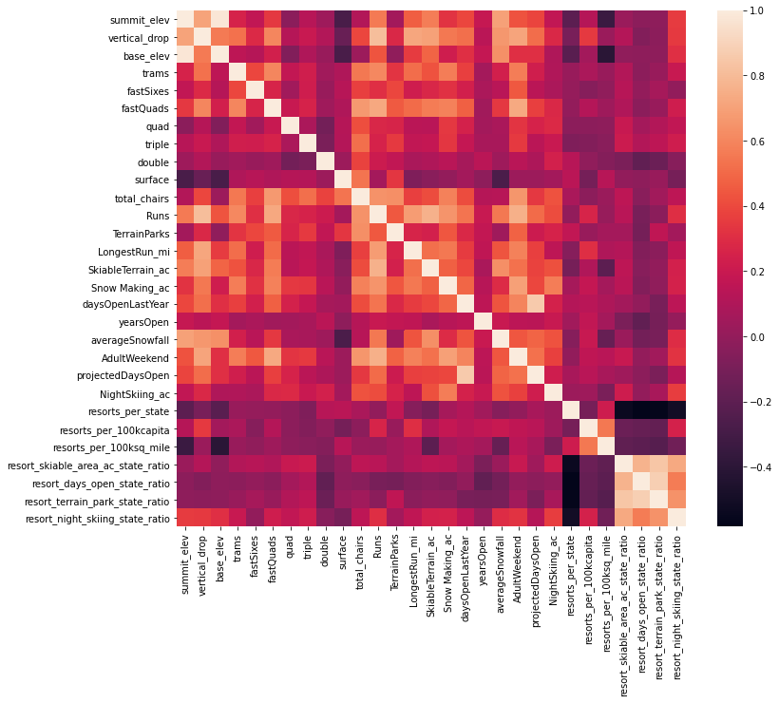
Data Insights
Shall we treat all states on equal footing? Yes:
We performed PCA using state features and analyzed the spread of state wise average ticket price on the first 2 PCA components. These 2 components seem to capture the relevant information about states with respect to ticket prices.
Correlation with target:
Ticket price is highly correlated with Snow Making acres. This correlation is stronger than correlation with total skiing area. It suggests that some guarantee of snow can fetch premium in ticket price. Vertical drop is positively correlated with ticket price. This is intuitive as it will incur higher transport & maintenance costs. fastQuads , Runs are highly correlated with ticket price.
Correlation within features:
Total chairs and Runs are correlated with each other. His seems intuitive as more runs means more chairs to ferry people. Ratio features are negatively correlated with the number of resorts in each state because if you increase the number of resorts in a state, the share of all the other state features will drop for each.

Slide 5
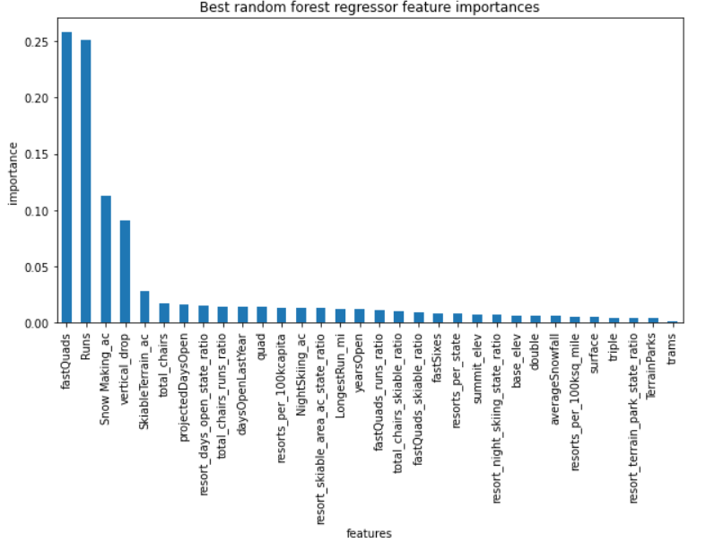
Modelling
Data Split : We exclude Big Mountain Resort entry and then split the data in 70/30 for train/test.
Matrix: We are using Mean Absolute Error(MAE) to access how good our model prediction is.
Cross-Validation: Using cross-validation, we observe that MAE in
Median < Mean imputation
Random Forest < Linear Regression
Hence, we choose Median imputation & Random Forest model for better predictions.
Feature importance:
Top 4 features are common in both the RF & LR models, indicating stability.
These are fastQuads, Runs, Snow making acres, vertical drop. This makes intuitive sense and is consistent with observed correlation.
Selecting top 8 features in RF gives us best bias-variance trade-off .

Slide 6
Conclusion
$$$
Top Class Resort
Scope to increase price
Recommendation
The Big Mountain is a top class resort in term of facilities it offers. It is amongst the resorts with the largest amount of skiable terrain. A very few resorts have more chairs, fastQuads, Longest Run than Big Mountain. It is the most expensive resort in Montana.
Big Mountain is charging $81 per ticket,. Given the facilities Big Mountain offers, there is a good opportunity to increase the ticket price by $14 as per best estimate and $4 as per conservative estimate. This is without adding a new facility or service.
Big Mountain can increase ticket price by $3.4. And, it can increase vertical drop by 200 feet, install a new chair and close 5 least used runs. This will lead to $4.2 million increase in profit. It is feasible to do so and will lead to more acceptability of price hike among customers.

Slide 7
Next Steps
Step 1 - Add Expenses
Step 2 - Add Consumer Attributes
We do not have operating cost information for facilities except for new chair. With additional information on operational costs, we can quantify and analyze marginal profit of adding/removing particular resource.
We do not know anything about number of customers visiting other resorts. With this, we can gain insight into popularity and price appeal of resorts, and we can perform price elasticity analysis. It will also help us in determining optimum resource utilization of a resort eg total chairs to number of daily visitors ratio.

